Slide 1
FSP6 Team 4
TMDB Movies Dataset
Beh Ming Jun U2022747E
Chun Wei Jie Benjamin U2022397G
Tang Han Kang U2022842C

Slide 2

“What factors determine a Movie’s success?”
Wise words —FSP6 Team 4

Slide 3
Data Extraction
TMDB API
OMDB API
Collect IDs of 10,000 movies from Popular Pages pg 1-500
Supplement missing values in TMDB dataset
01
02
03
04
TMDB API
Consolidation
Request and get movie details for the 10,000 movies
Combine and export as CSV file

Slide 4

Data Cleaning
Genre
Awards
Original Language
Numerical Data
Main Genre is the first genre listed
Whether a movie received an award
Replacing language acronym for easier understanding
Removing invalid rows and converting to numerical
01
02
03
04

Slide 5
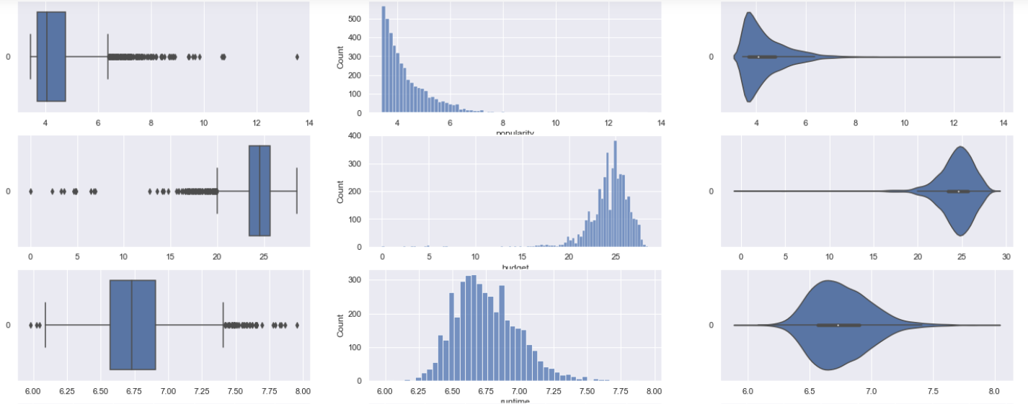
Exploratory Analysis (1)
Popularity
Budget
Runtime

Slide 6
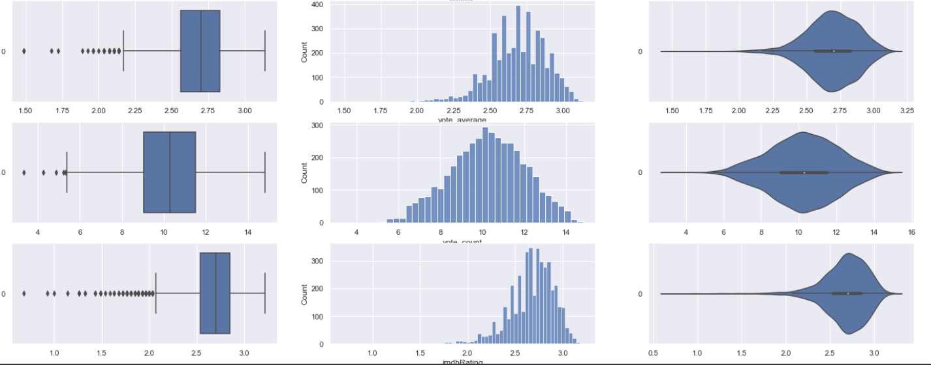
Exploratory Analysis (2)
Vote Average
Vote Count
IMDB Rating

Slide 7
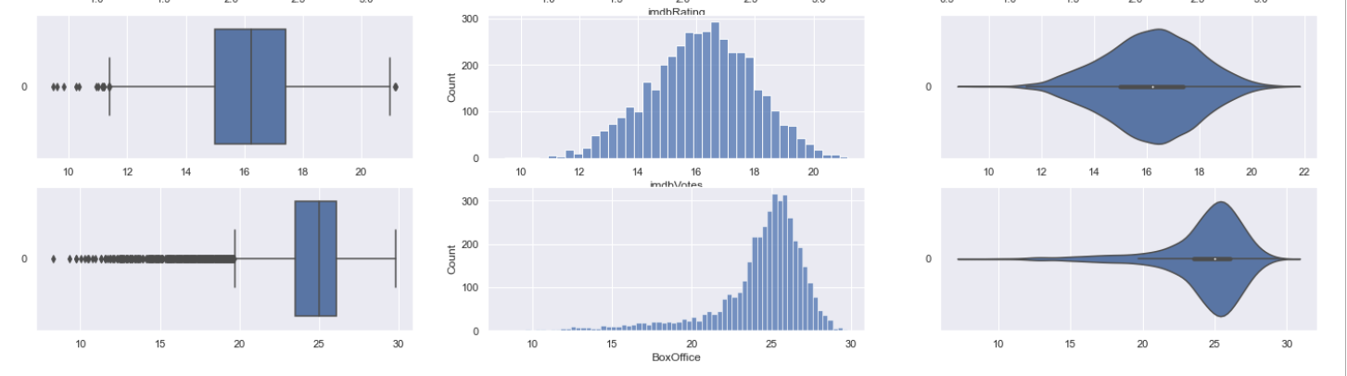
Exploratory Analysis (3)
IMDB Votes
Box Office

Slide 8
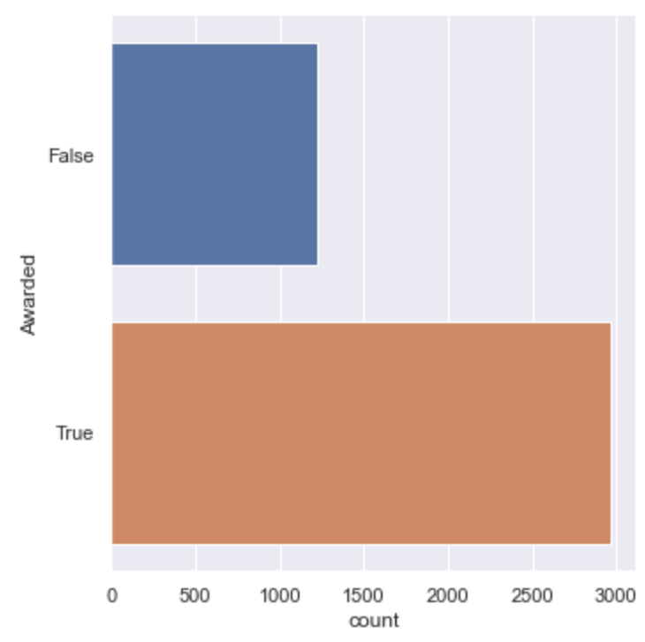
Exploratory Analysis (4)
Count Plot for Categorical Data: “Awarded”

Slide 9
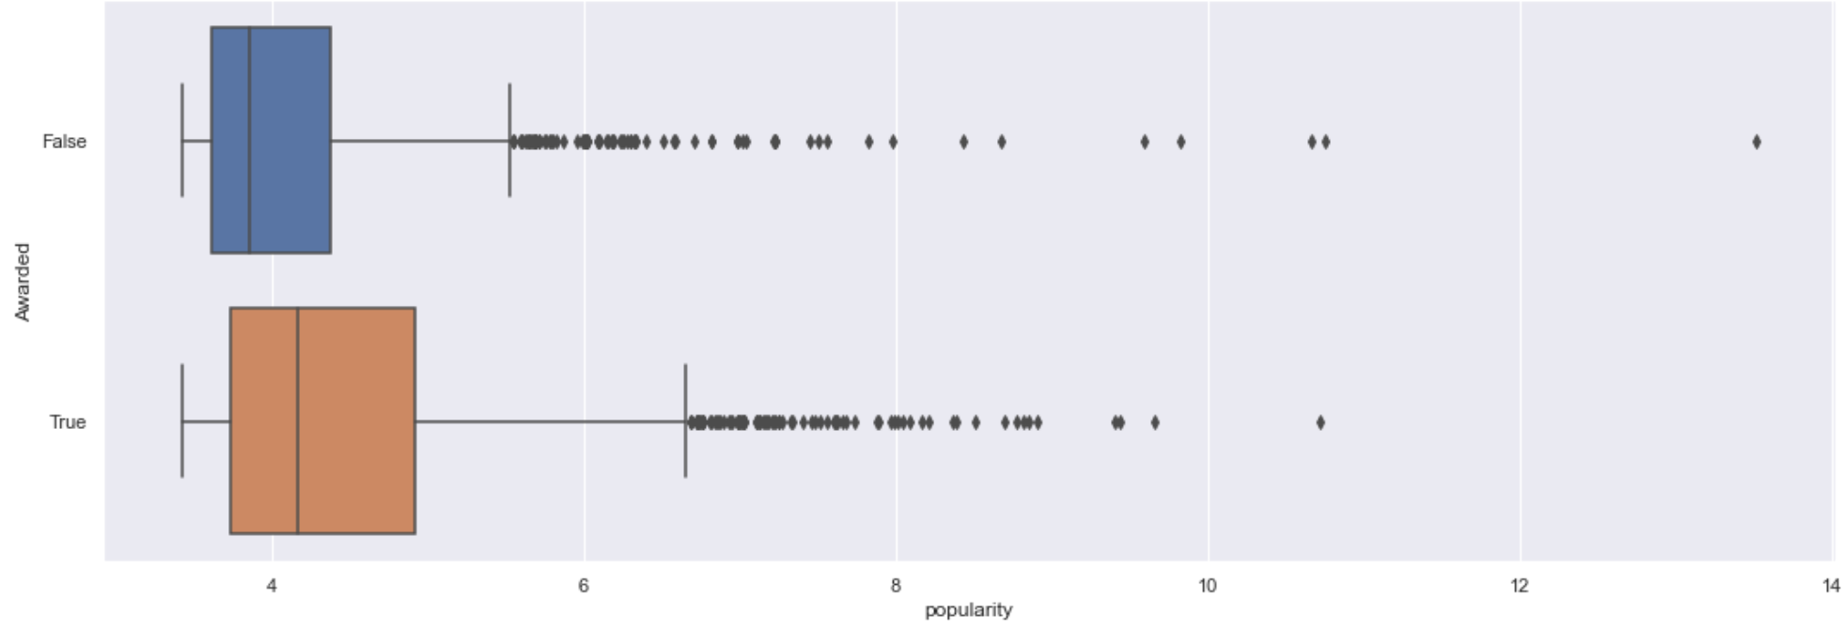
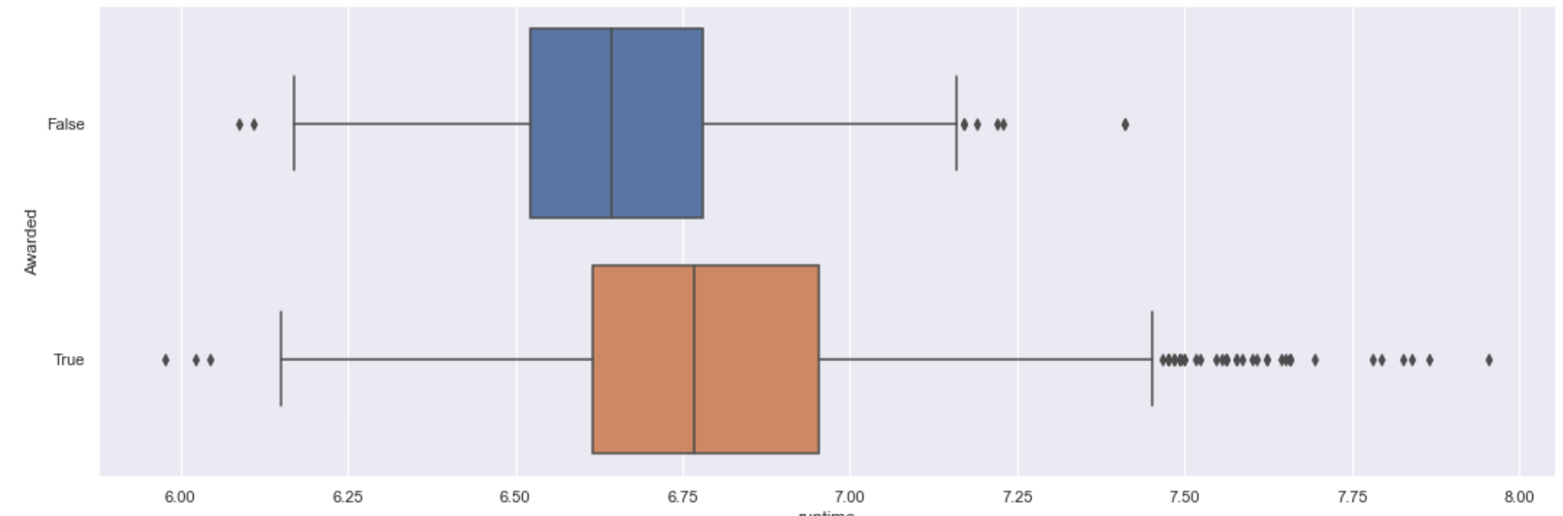
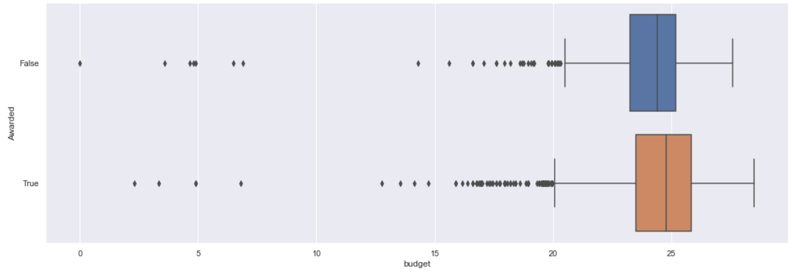
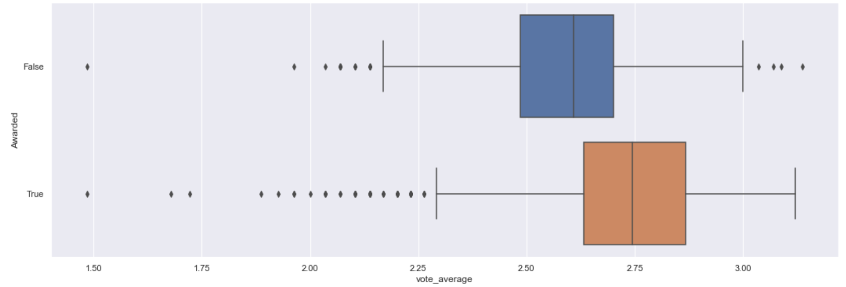
Exploratory Analysis (5)
Popularity
Runtime
Budget
Vote Average

Slide 10
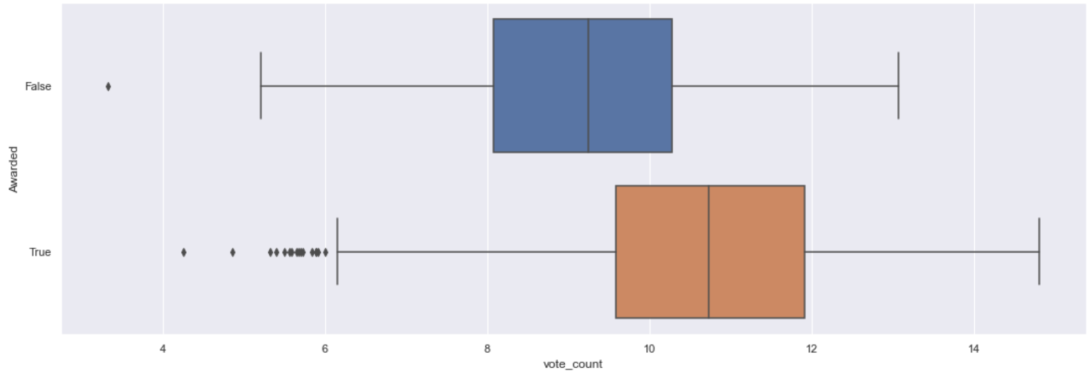
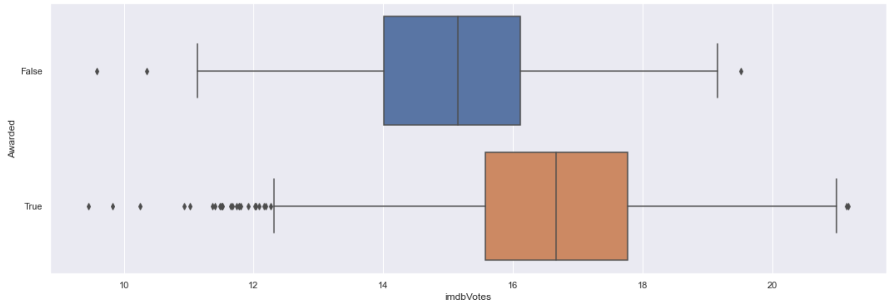
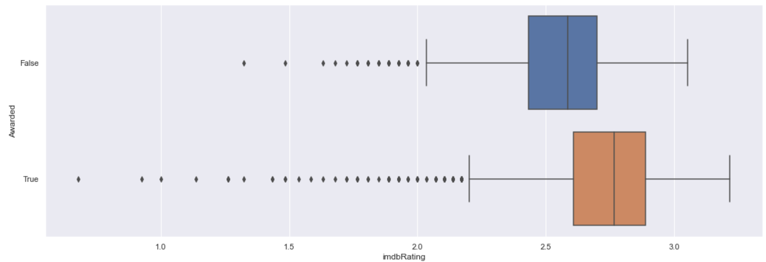
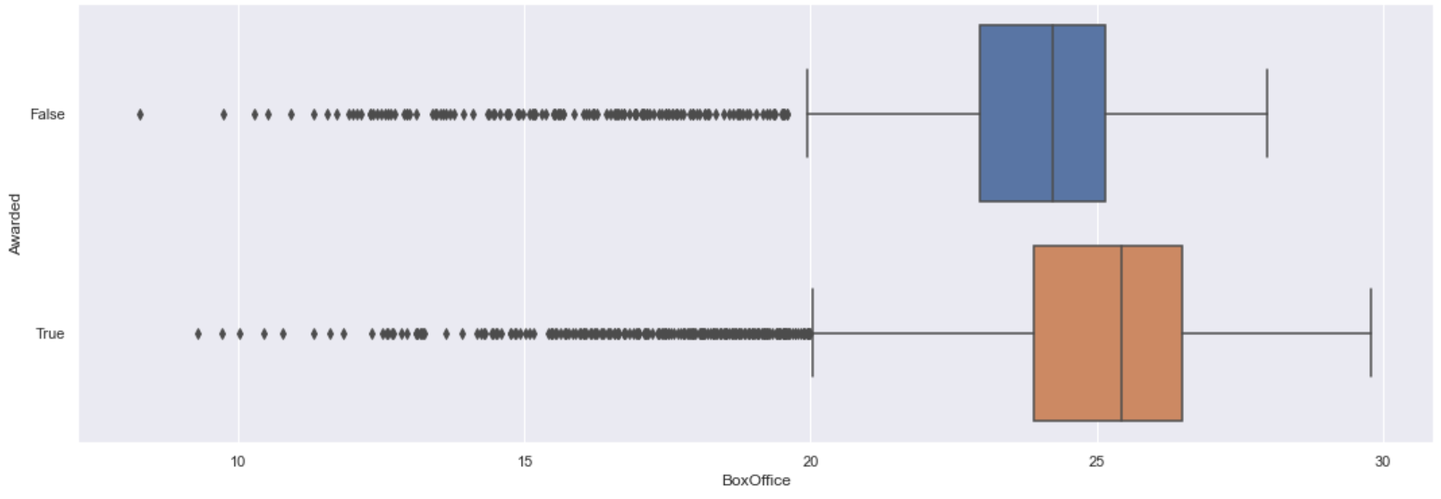
Exploratory Analysis (6)
Vote Count
imdbVotes
imdbRating
Box Office

Slide 11
Definitions of a Successful Movie
Won an Award
2. High Box Office Sales
Notes:
When studying the data set, we realised that the award column was not suitable for usage. We created a new column, Nominated/Received Awards. If a movie had non null inputs in the award columns, we marked them as True in the new column, otherwise they are marked as false.

Slide 12
Classification
01
Importance of each variable in predicting whether a movie received an award
Notes:
When we talk about the success of a movie, we might consider whether or not the movie has been nominated for or received an award. Some of the more well known awards are: the EMMYS, Golden Globe and the Academy Awards. By utilising machine learning models, we want to find the significance of each numeric variables in predicting whether a movie was awarded.

Slide 13
Categorising the Movies
True
False
Movies that received or were nominated for awards.
Movies that were not nominated for awards
Notes:
When studying the data set, we realised that the award column was not suitable for usage. We created a new column, Nominated/Received Awards. If a movie had non null inputs in the award columns, we marked them as True in the new column, otherwise they are marked as false.

Slide 14
Which Numerical Variables Did We Consider?
Popularity
Budget
Runtime
IMDB Ratings
Vote Average (TMDB)
Vote Count (TMDB)
Box Office
IMDB Votes
Notes:
Now that we have our response variable settled. We need to choose suitable predictor variables. For this segment, we chose the following numerical variables as our predictor. Popularity, budget, runtime, box office, vote average, vote count, imdb ratings, imdb votes.

Slide 15

Model 1
RandomForestClassifier
Notes:
To ensure that the previous results were nota fluke, we decided to use the random forest classifier. Random forest is an ensemble tool which takes a subset of response and predictors to build multiple decision tress. Which are then combine together to get a more accurate and stable prediction.

Slide 16




Why RandomForestClassifier?

Slide 17
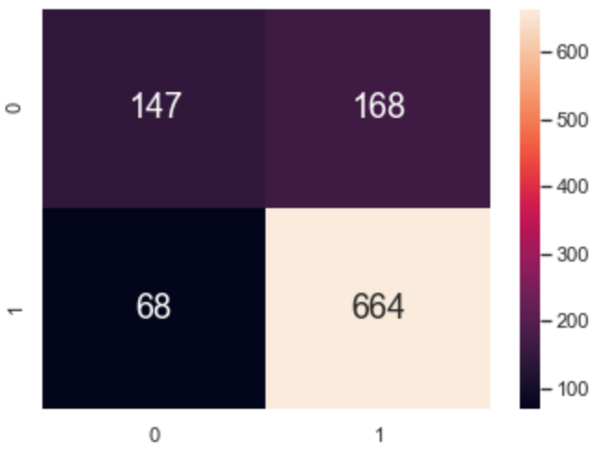
Classification Accuracy
Test
Classification Accuracy : 0.7745940783190067
False Positive Rate : 0.53
Notes:
Even though the classification accuracy remained high, the false positive rate of our model is 1, which is very undesirable for a classification model. We observe this because of the huge imbalance in our data set. The majority class, awarded movies, heavily influence our classification model, at the cost of ignoring the minority class. Next, I will be sharing a few methods we tried, to handle the imbalanced data.

Slide 18
Model 2
SMOTE
Notes:
Instead of random over sampling, we considered Synthetic Minority Over-sampling Technique. Also known as Smote. This method generates synthetic minority data, using the K-nearest neighbours of minority instances.

Slide 19
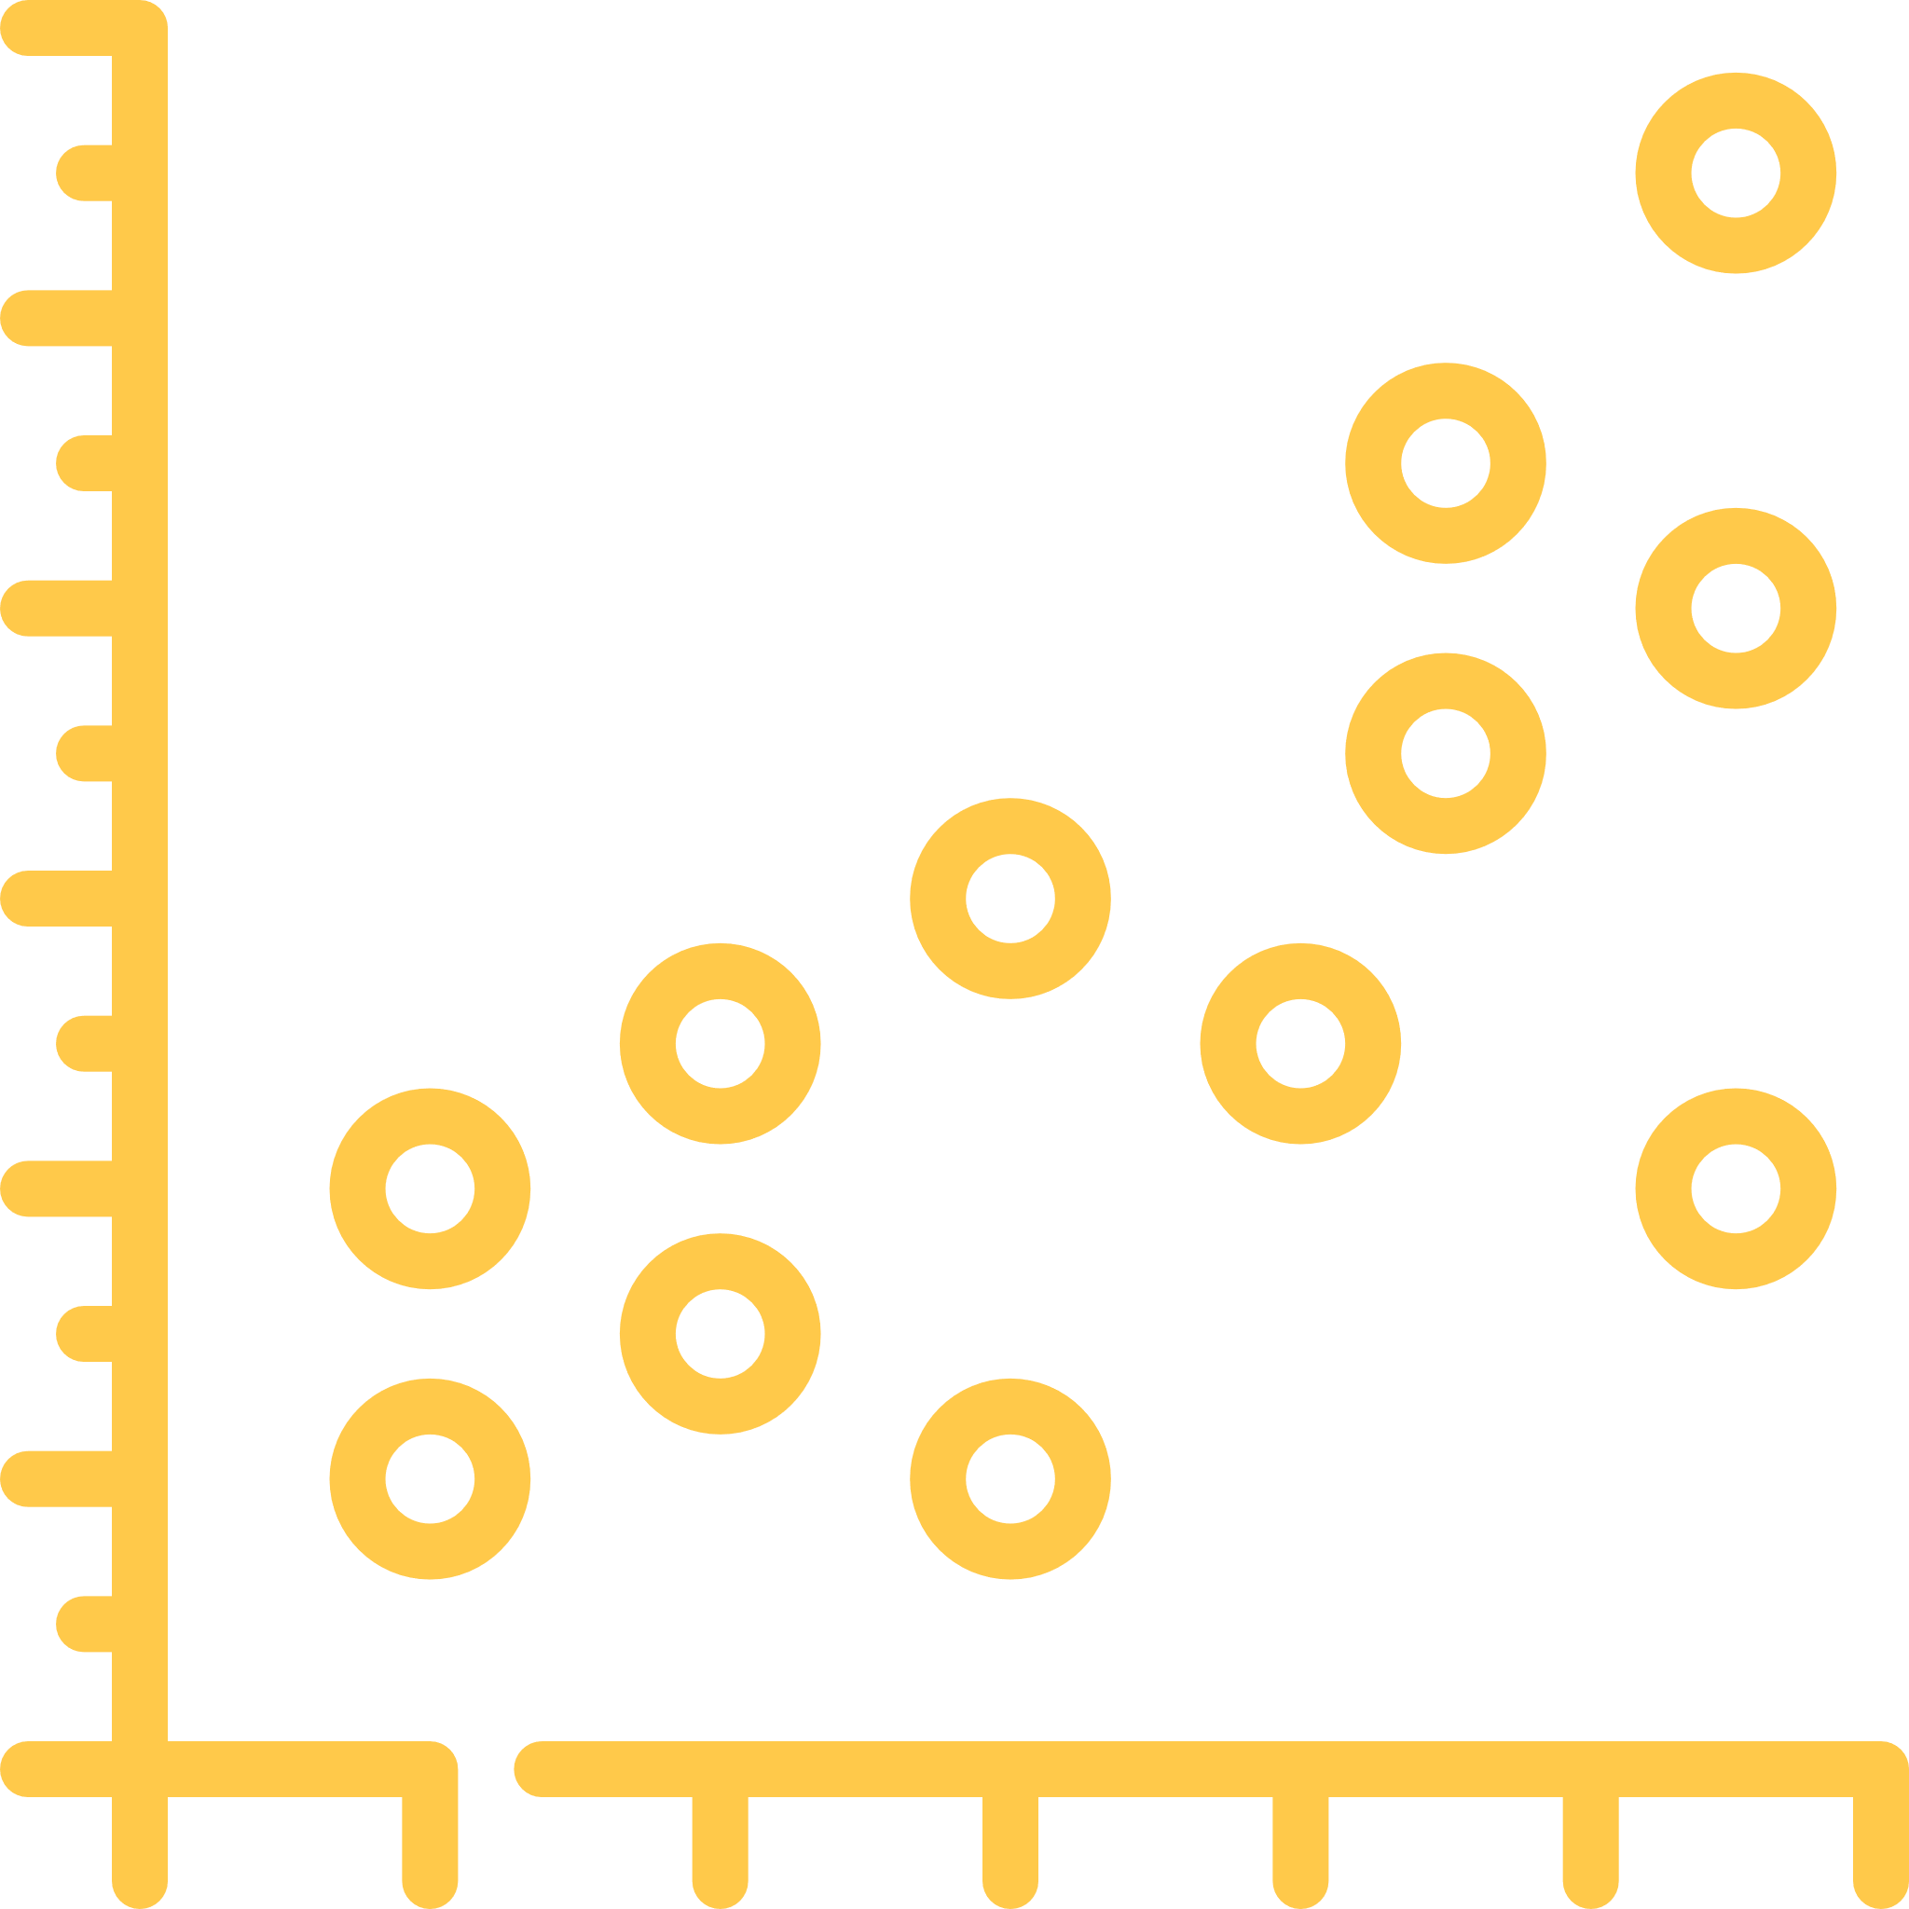
Beyond the Course: SMOTE
Notes:
Now that we have our response variable settled. We need to choose suitable predictor variables. For this segment, we chose the following numerical variables as our predictor. Popularity, budget, runtime, box office, vote average, vote count, imdb ratings, imdb votes.

Slide 20
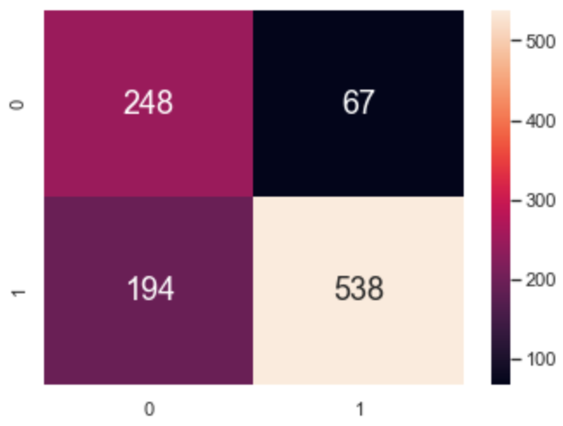
Classification Accuracy
Test
Classification Accuracy : 0.7507163323782235
False Positive Rate : 0.21
Notes:
The classification accuracy for both the training and test data set improved. Hence, we will be using this model to conclude. the feature importance of our predictor variable.

Slide 21
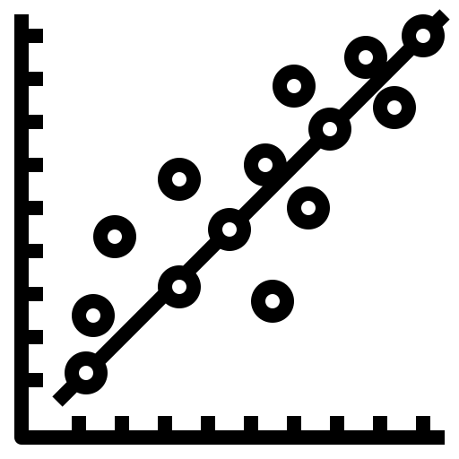
Regression
02
Importance of Budget and Runtime in predicting the Box Office of a movie

Slide 22

Why and How Regression Solves the Problem
Budget (Numerical)
Runtime (Numerical)
Predict
Or
Box Office (Numerical)
Notes:
Now that we have our response variable settled. We need to choose suitable predictor variables. For this segment, we chose the following numerical variables as our predictor. Popularity, budget, runtime, box office, vote average, vote count, imdb ratings, imdb votes.

Slide 23
K Nearest Neighbors Regressor
Model 1

Slide 24
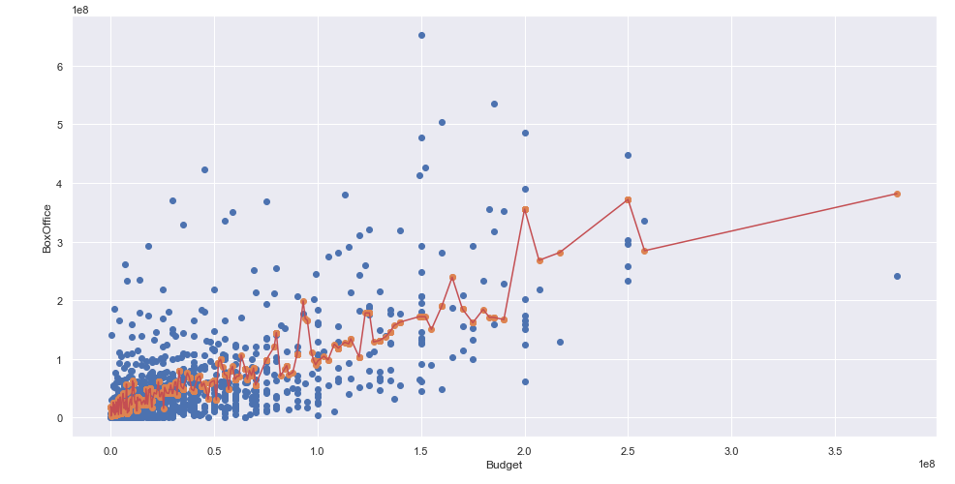
K Nearest Neighbors Regressor
Averaging the box office value of K number of nearest neighbors to predict the box office value of a predictor variable.

Slide 25
Decision Tree Regressor
Model 2

Slide 26
Decision Tree Regressor
budget <= 73500000
nmse = 59643933706352
nsamples = 3140
nvalue = 57670839.953
Given a data, the decision tree splits into two sub-nodes and calculates the MSE of each sub-node and ultimately chooses the sub-node with smallest MSE value.
budget <= 25765000.0
mse = 208686682282167
samples = 2627
value = 40121186.015
budget <= 197500000.0
mse = 1.616699269e+16
samples = 513
value = 147540120.452
mse = 139462108711
samples = 1602
value = 2858377
mse = 263559460545
samples = 1025
value = 58153313.199
mse = 827314413747
samples = 461
value = 126782392.23
mse = 4.8463759e+16
samples = 52
value = 331565364.86

Slide 27
Polynomial Regression
Model 3

Slide 28
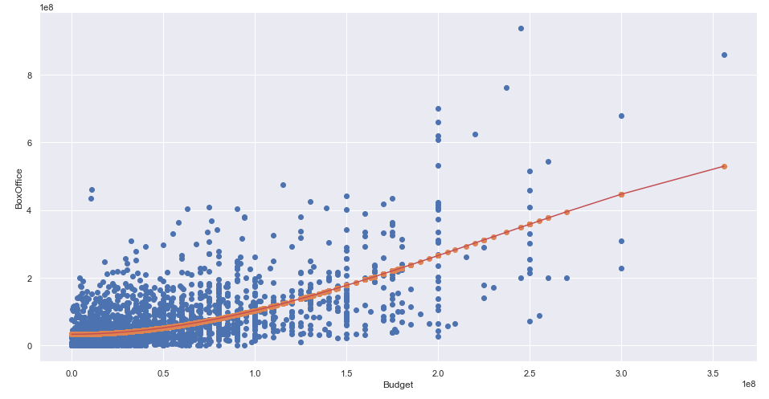
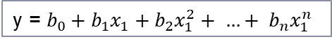
Polynomial Regression
y = $b_{0}+b_{1}x_{1}+b_{2}x_{1}^{2}+ …+ b_{n}x_{1}^{n}$
Polynomial Regression can fit on different curvature which can help to predict box office in case of non-linear relationship with predictor variable.

Slide 29
Beyond the Course: Hyperparameter Tuning
Example: K Nearest Neighbors Regressor
vs.
N_neigbors = 5
N_neigbors = 1
Notes:
Now that we have our response variable settled. We need to choose suitable predictor variables. For this segment, we chose the following numerical variables as our predictor. Popularity, budget, runtime, box office, vote average, vote count, imdb ratings, imdb votes.

Slide 30

Beyond the Course: Multivariate Regression
Budget (Numerical)
Runtime (Numerical)
Predict
Box Office (Numerical)
Notes:
Now that we have our response variable settled. We need to choose suitable predictor variables. For this segment, we chose the following numerical variables as our predictor. Popularity, budget, runtime, box office, vote average, vote count, imdb ratings, imdb votes.

Slide 31

Clustering
03
Unsupervised machine learning model with NLTK to analyse unstructured text data

Slide 32
Why use Overview?
Provides the largest amount of unstructured text
Has clear links with Genre, Actors, etc
Could affect viewership

Slide 33
Approach 1
Approach 2
Using ‘overview’ to find clusters with Successful Movies
Cluster using success indicators before analysing overview
K-Means
Minimise Cluster Sum of Squares to determine cluster centres and hence clusters
Notes:
Cluster to find out potential clusters that might show SUCCESS of Movie using ‘overview’
Cluster using indicators of successful movies such as Box office and Nominated or Awarded and then analysing the overview using NLTK

Slide 34
Beyond the Course: Natural Language Processing
Tokenisation
Stemming
Break down sentences, into words
Filter tokens that are entirely numerical or punctuation
Bring word from different form back to its root word
Notes:
When studying the data set, we realised that the award column was not suitable for usage. We created a new column, Nominated/Received Awards. If a movie had non null inputs in the award columns, we marked them as True in the new column, otherwise they are marked as false.
Introducing 2 concepts: Stemming and Tokenisation
in essence, it helps to reduce the word input into the root word AND breaks down the sentences and words for storing

Slide 35
Beyond the Course: Term Frequency-Inverse Document Frequency (TF-IDF)
Accounts for the frequency of the word
Reduces the importance of the word if it appears in other documents
Notes:
Data processing might take awhile hence we limit to top 100 datasets
we must also convert our textual plot summaries to numbers for the computer to be able to extract meaning from them. One simple method of doing this would be to count all the occurrences of each word in the entire vocabulary and return the counts in a vector.
we use Term Frequency-Inverse Document Frequency (TF-IDF) to accounts for the frequency of the word in this sentence, but reduces the importance of the word if it frequently appears in other documents
After we consider this, we then fit the model which

Slide 36
Clustering
Using “Overview”
Approach
1

Slide 37
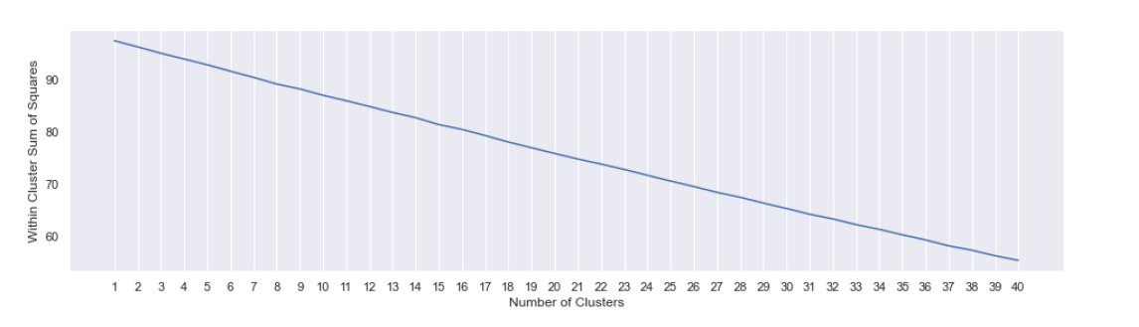
Approach 1
Notes:
We first fit the text into the Vectoriser and then transform the text into the corresponding numeric form of the data
once we have fitted our model, we need to create clusters, but how many? We plot a graph of Cluster Sum of Squares against Clusters, note that as number of clusters increase, the CSS will definitely fall until we have CSS=0 and no of clusters=no of variables
no convincing elbow point hence, we try our luck and find that 5 works pretty well

Slide 38
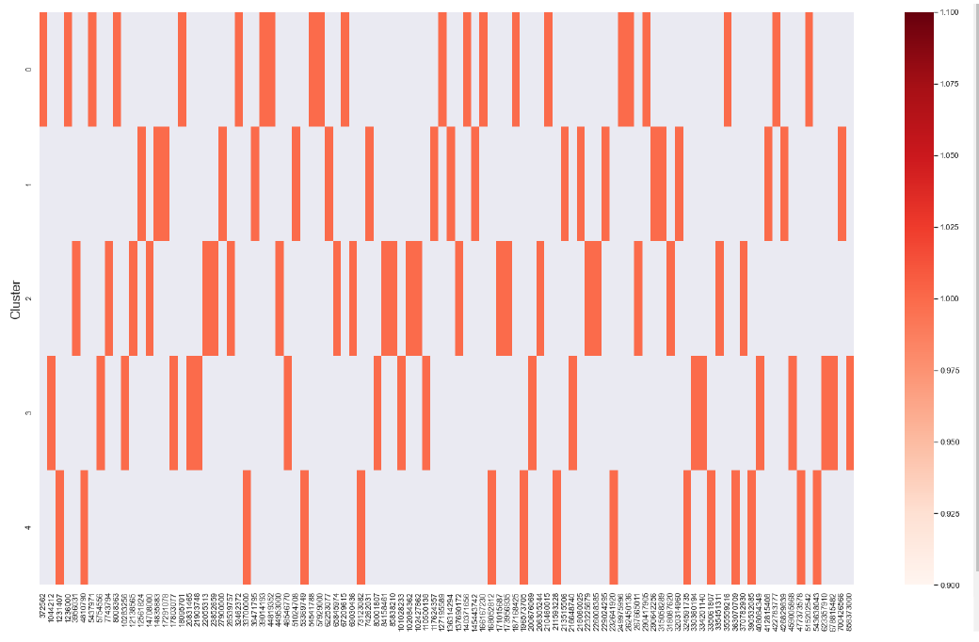
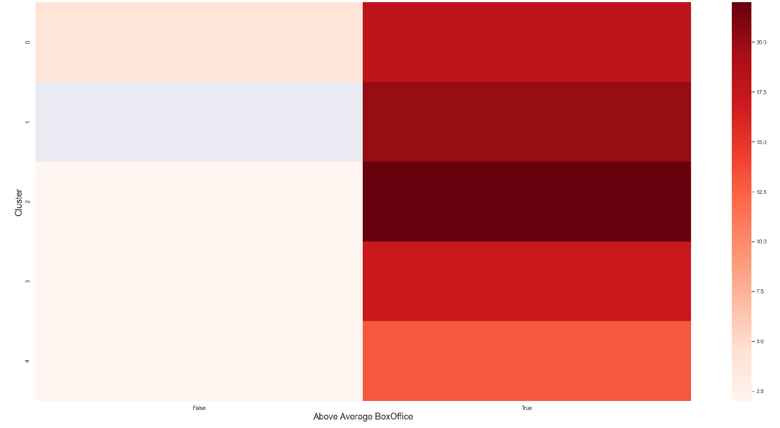
Distribution of Box Office and Clusters
Box Office for individual movies within Cluster
Concentration of movies with Above and Below average Box Office for clusters

Slide 39
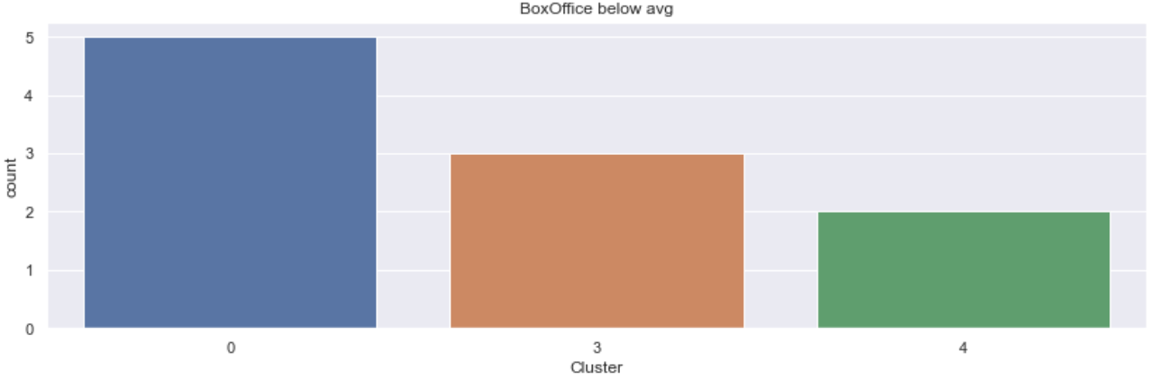
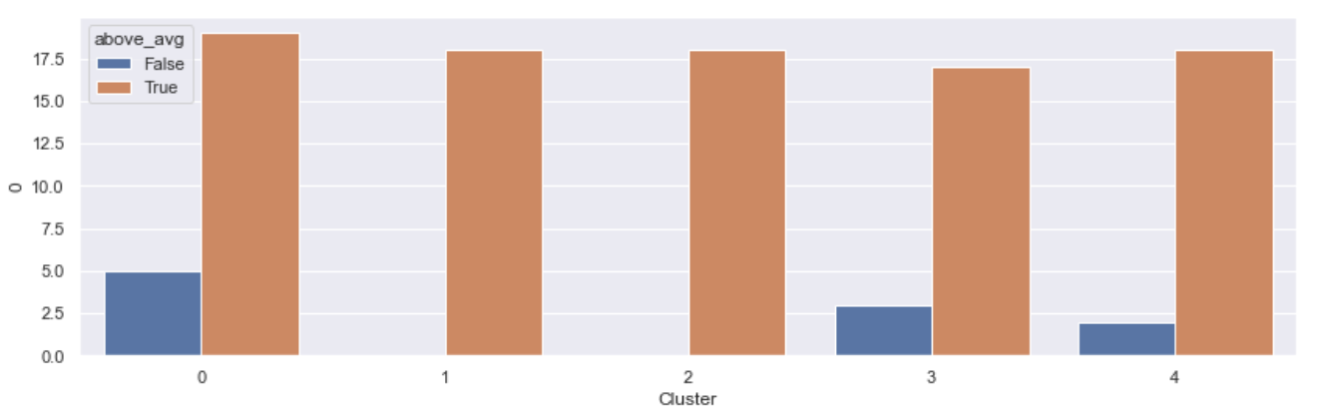
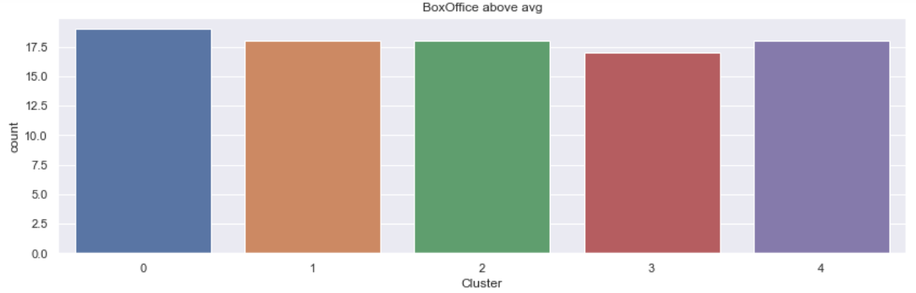
Cluster 1: 100%
Cluster 2: 100%
Notes:
Cluster sizes
by visual inspection we can see that CLUSTER 4 is doing well in terms of number of BOXOFFICE above avg. followed by CLUSTER 2
analysising the overview gives us an understanding of what movies are in each of the clusters and could give us some indication of words that might enable the movie to be more successful.
by visual inspection we can see that CLUSTER 4 is doing well in terms of number of BOXOFFICE above avg.followed by CLUSTER 2

Slide 40
Top Words from Notable Clusters
Cluster 1
Cluster 2
young, forc, crime, past, escap, hit, join, woman, assassin, face
harri, learn, year, turn, black, hogwart, find, ancient, new, live

Slide 41
Clustering
Using BoxOffice and Rcvd Awards
Approach
2

Slide 42
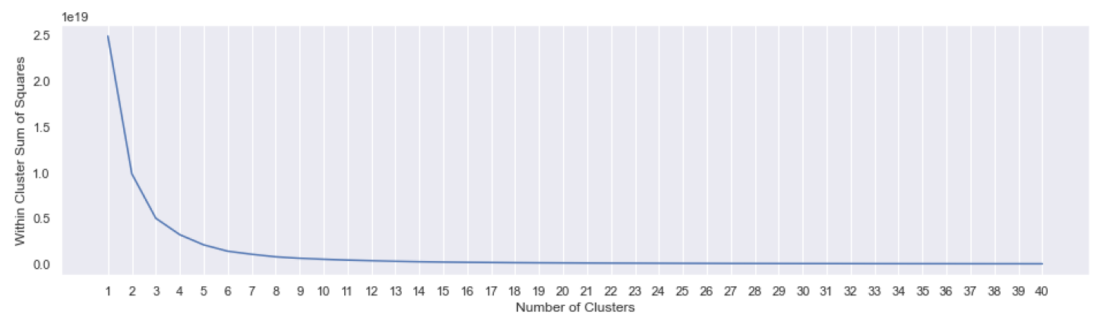
Approach 2
Notes:
Right off the bat we can see a nice plot of the within cluster sum of squares which might be a good sign

Slide 43
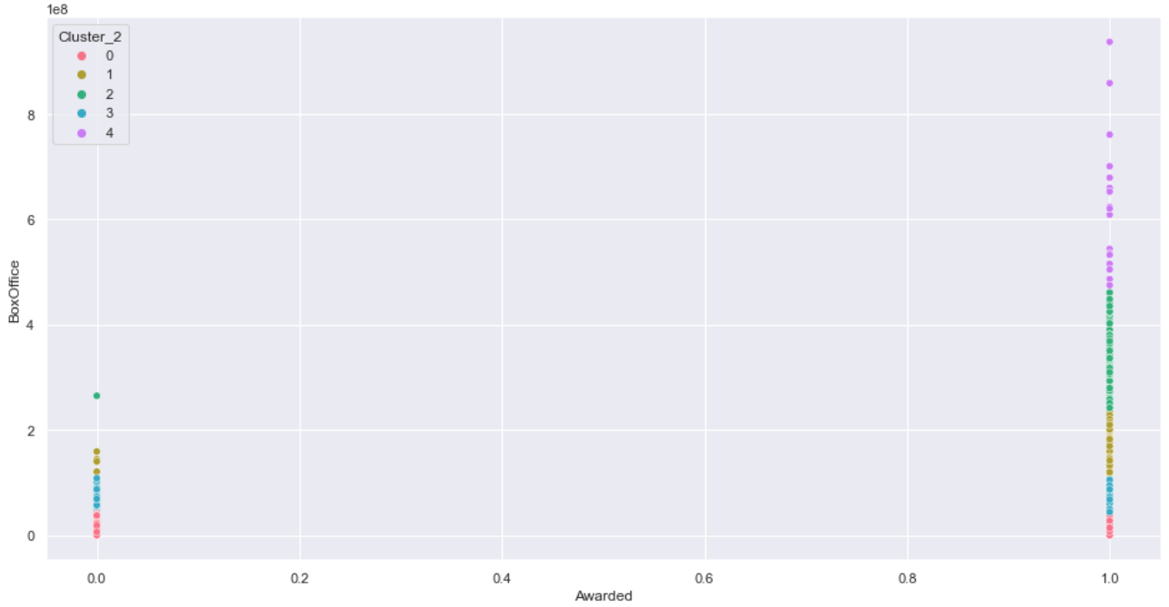
Clustering Result
Cluster 4
Cluster 2
order, new, resistance, avengers, battle, meanwhile, young, first, learn, world
world, life, new, harry, man, must, help, peter, evil, named

Slide 44

Outcomes and Recommendations

Slide 45
Classification
Random Forest Classifier :
Classification Accuracy : 0.7745940783190067
False Positive Rate : 0.53
Random Forest Classifier with SMOTE:
Classification Accuracy : 0.7507163323782235
False Positive Rate : 0.21

Slide 46
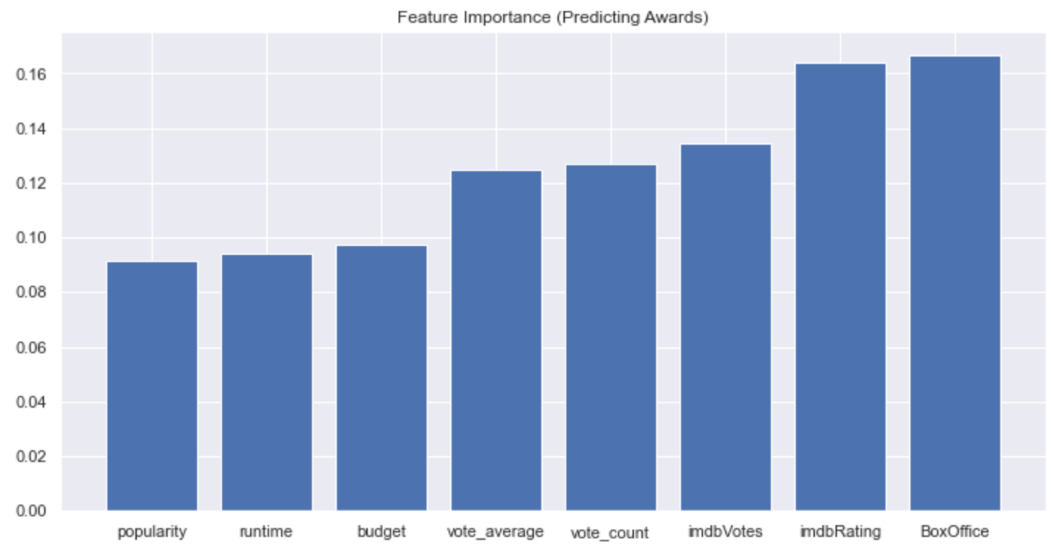
Classification
Budget and runtime does not have a huge impact
Movie makers should not spend too much resource in finding the optimal runtime and budget

Slide 47
Regression
Interesting Findings:
After tuning the hyperparameters:
The best degree for single variate polynomial regression is 1, which indicates that the data suits a linear relationship more than a non-linear relationship with a curve.
2. The best model for predicting box office:
Budget → Decision Tree Regressor: R^2 value = 0.44375
Runtime -> KNN Regressor: R^2 value = 0.068842

Slide 48
Regression
Recommendation:
To produce a successful movie, movie makers can consider their budget carefully. The higher the movie budget allocated, the box office is also likely to be higher. Conversely, runtime might not be a big concern.
Budget (Numerical)
Runtime (Numerical)

Slide 49
Clustering
Findings:
Both ventures gave similar results
‘hit’, ‘escape’, ‘assasin’, ‘face’ indicates some form of Action scenes within the successful clusters
Words from ventures indicate that Superpowers or Fantasy are common features of top movies
Recommendation:
Incorporate Action and Crime themes and elements into movies to fall into same successful cluster

Slide 50

Workload Division

Slide 51
Workload Division
Beh Ming Jun
Data Cleaning, Regression Problem, Slides
Chun Wei Jie Benjamin
Data Collection/Cleaning, Clustering Problem, Slides
Tang Han Kang
Data Cleaning, Classification Problem, Slides

Slide 52

Thank you

Slide 53
References
https://www.analyticsvidhya.com/blog/2018/03/introduction-k-neighbours-algorithm-clustering/
https://gdcoder.com/decision-tree-regressor-explained-in-depth/
https://towardsdatascience.com/introduction-to-linear-regression-and-polynomial-regression-f8adc96f31cb#:~:text=Advantages%20of%20using%20Polynomial%20Regression,a%20wide%20range%20of%20curvature.
https://www.ritchieng.com/machine-learning-efficiently-search-tuning-param/
https://towardsdatascience.com/machine-learning-model-selection-and-hyperparameter-tuning-736158357dc4

Slide 54
References
https://analyticsindiamag.com/guide-to-hyperparameters-tuning-using-gridsearchcv-and-randomizedsearchcv/
https://github.com/YashMotwani/TMDB-Movies-Dataset-Investigation-/blob/master/TMDB_Movies_Dataset_Analysis.ipynb
https://github.com/siddharthajit/Movie-Clustering
https://towardsdatascience.com/what-makes-a-successful-film-predicting-a-films-revenue-and-user-rating-with-machine-learning-e2d1b42365e7
https://towardsdatascience.com/grid-search-for-model-tuning-3319b259367e

Slide 55
References
https://github.com/rian-van-den-ander/encode_json_data_within_dataframe/blob/master/encode_json_column.py

